Slide 1
IOT BASED SMART CAR PARKING SYSTEM
SUBMITTED BY

Slide 2
ABSTRACT
System demonstrates a fully automated car parking system that also gives an update regarding parking availability on IOT Gecko website through internet. For this purpose we use IR sensors along with motors, LCD display and microcontroller for controlling the system working. Our system consists of an LCD display that is used to demonstrate as a parking gate entrance display. The display displays empty slots to new car arriving at gate of parking area. If no parking space is available the system does not open the gate and displays parking full. If slot is empty system allows car to enter the lot and displays empty slots where user can park. To detect vehicle slot occupancy the system uses IR sensors. Also system uses IR sensors to detect vehicles arriving at parking gates, to open the gates automatically on vehicle arrival. The microcontroller is used to facilitate the working of the entire system.
To have more convenience to the drivers as well as the parking area monitoring people, the parking space availability information is in parallel sent to IOT website through Wi-Fi connection to the system. In this way with a live feed on where to go for parking the vehicle, the time and cost involved in searching an available parking slot is thus saved. This is how the IOT Based Smart Car Parking System works.

Slide 3
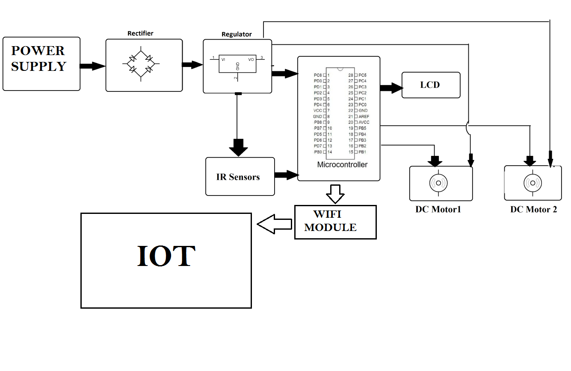
BLOCK DIAGRAM

Slide 4
HARD WARE EQUIPMENTS
Atmega 328 Microcontroller
WIFI MODULE
LCD Display
IR Sensors
Motors
Transformer
Resistors
Capacitors
Diodes

Slide 5
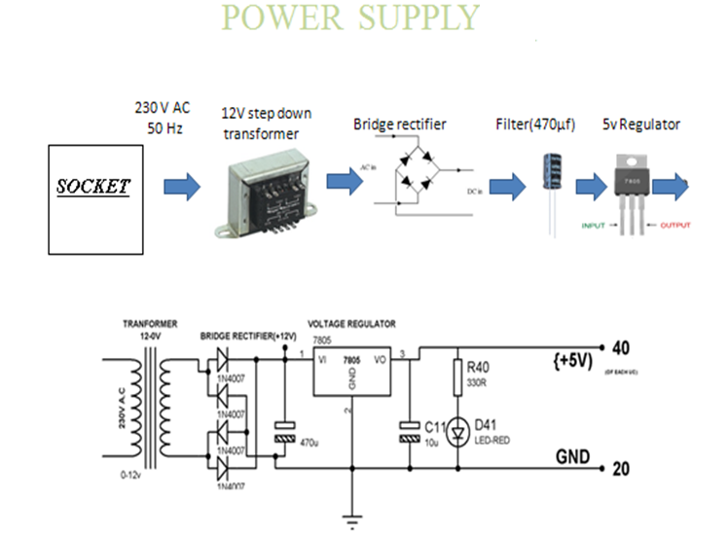

Slide 6
EMBEDDED SYSTEMS
Definition for :- EMBEDDED SYSTEMS
A combination of hardware and software which together
form a component of a larger machine.
An example of an embedded system is a microprocessor that
controls an automobile engine.
An embedded system is designed to run on its own without
human intervention, and may be required to respond to
events in real time.

Slide 7
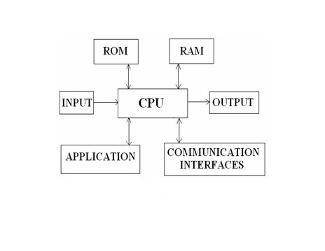
EMBEDDED SYSTEMS

Slide 8
Microcontroller
It is a smaller computer
Has on-chip RAM, ROM, I/O ports...
CPU
RAM
ROM
A single chip
Serial COM Port
I/O Port
Timer
Microcontroller

Slide 9
Features of Atmega328
High Performance, Low Power AVR® 8-Bit Microcontroller
– Advanced RISC Architecture
– 131 Powerful Instructions
– Most Single Clock Cycle Execution
– 32 x 8 General Purpose Working Registers
– Fully Static Operation
– Up to 20 MIPS Throughput at 20 MHz
– On-chip 2-cycle Multiplier
Flash Program Memory: 32 kbytes
EEPROM Data Memory: 1 kbytes
SRAM Data Memory: 2 kbytes
I/O Pins: 23
Timers: Two 8-bit / One 16-bit
A/D Converter: 10-bit Six Channel
PWM: Six Channels
RTC: Yes with Separate Oscillator
MSSP: SPI and I²C Master and Slave Support
USART: Yes
External Oscillator: up to 20MHz

Slide 10
Block diagram of mc
External interrupts
On-chip ROM for program code
Timer/Counter
Interrupt Control
On-chip RAM
Timer 1
Counter Inputs
Timer 0
CPU
Bus Control
Serial Port
4 I/O Ports
OSC
P0 P1 P2 P3
TxD RxD
Address/Data

Slide 11
PIN count: Atmega32 has got 40 pins. Two for Power (pin no.10: +5v, pin no. 11: ground), two for oscillator (pin 12, 13), one for reset (pin 9), three for providing necessary power and reference voltage to its internal ADC, and 32 (4×8) I/O pins.
About I/O pins: ATmega32 is capable of handling analogue inputs. Port A can be used as either DIGITAL I/O Lines or each individual pin can be used as a single input channel to the internal ADC of ATmega32, plus a pair of pins AREF, AVCC & GND together can make an ADC channel.
No pins can perform and serve for two purposes (for an example: Port A pins cannot work as a Digital I/O pin while the Internal ADC is activated) at the same time. It’s the programmers responsibility to resolve the conflict in the circuitry and the program. Programmers are advised to have a look to the priority tables and the internal configuration from the datasheet.
Digital I/O pins: ATmega32 has 32 pins (4portsx8pins) configurable as Digital I/O pins.

Slide 12
Cont..
Timers: 3 Inbuilt timer/counters, two 8 bit (timer0, timer2) and one 16 bit (timer1).
ADC: It has one successive approximation type ADC in which total 8 single channels are selectable. They can also be used as 7 (for TQFP packages) or 2 (for DIP packages) differential channels. Reference is selectable, either an external reference can be used or the internal 2.56V reference can be brought into action. There external reference can be connected to the AREF pin.
Communication Options: ATmega32 has three data transfer modules embedded in it. They are
Two Wire Interface
USART
Serial Peripheral Interface

Slide 13
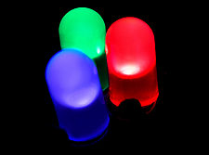
LED
LEDs are semiconductor devices are made out of silicon
When current passes through the LED, it emits photons as a byproduct. Normal light bulbs produce light by heating a metal filament until its white hot
LEDs present many advantages over traditional light sources including lower energy consumption, longer lifetime, improved robustness, smaller size and faster switching

Slide 14
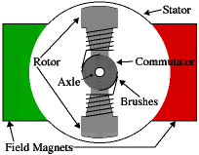
DC- MOTOR
A DC motor is an electric motor that runs on direct current (DC) electricity. In any electric motor, operation is based on simple electromagnetism.
A simple 2-pole DC electric motor (here red represents a magnet or winding with a "North" polarization, while green represents a magnet or winding with a "South" polarization).
Every DC motor has six basic parts -- axle, rotor (a.k.a., armature), stator, commutator, field magnet(s), and brushes.

Slide 15
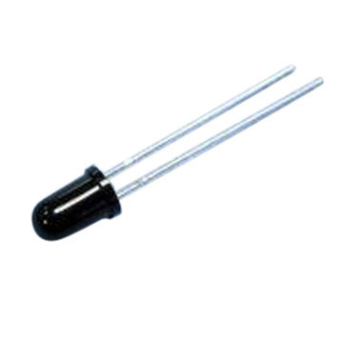

PHOTO DIODE
A photodiode is a type of photo detector capable of converting light into either current or voltage, depending upon the mode of operation.
Photodiodes are similar to regular semiconductor diodes except that they may be either exposed (to detect vacuum UV or X-rays) or packaged with a window or optical fibre connection to allow light to reach the sensitive part of the device.

Slide 16
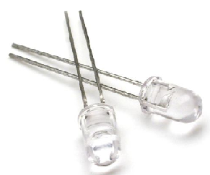
IR LED
An IR LED, also known as IR transmitter, is a special purpose LED that transmits infrared rays in the range of 760 nm wavelength.
Such LEDs are usually made of gallium arsenide or aluminum gallium arsenide. They, along with IR receivers, are commonly used as sensors.
The appearance is same as a common LED. Since the human eye cannot see the infrared radiations, it is not possible for a person to identify whether the IR LED is working or not, unlike a common LED.
To overcome this problem, the camera on a cell phone can be used. The camera can show us the IR rays being emanated from the IR LED in a circuit.

Slide 17
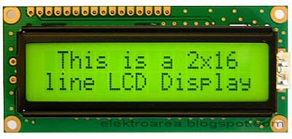
LIQUID CRYSTAL DISPLAY (LCD)
Most common LCDs connected to the microcontrollers are 16x2 and
20x2 displays.
This means 16 characters per line by 2 lines and 20 characters per line
by 2 lines, respectively.
The standard is referred to as HD44780U, which refers to the controller
chip which receives data from an external source (and communicates
directly with the LCD.

Slide 18
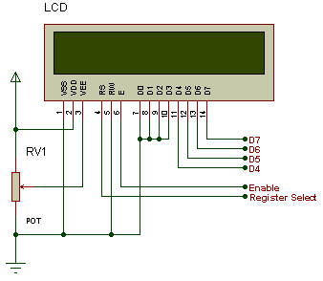
LCD BACKGROUND
If an 8-bit data bus is used the LCD will require 11 data lines
(3 control lines plus the 8 lines for the data bus)
The three control lines are referred to as EN, RS, and RW
EN=Enable (used to tell the LCD that you are sending it data)
RS=Register Select (When RS is low (0), data is treated as a command)
(When RS is High(1), data being sent is text data )
R/W=Read/Write (When RW is low (0), the data written to the LCD)
(When RW is low (0), the data reading to the LCD)

Slide 19
Software Requirements
The Arduino project provides the Arduino integrated development environment (IDE), which is a cross-platform application written in the programming language Java. It originated from the IDE for the languages Processing and Wiring. It is designed to introduce programming to artists and other newcomers unfamiliar with software development. It includes a code editor with features such as syntax highlighting, brace matching, and automatic indentation, and provides simple one-click mechanism to compile and load programs to an Arduino board. A program written with the IDE for Arduino is called a "sketch".
The Arduino IDE supports the languages C and C++ using special rules to organize code. The Arduino IDE supplies a software library called Wiring from the Wiring project, which provides many common input and output procedures. A typical Arduino C/C++ sketch consist of two functions that are compiled and linked with a program stub main() into an executable cyclic executive program:

Slide 20
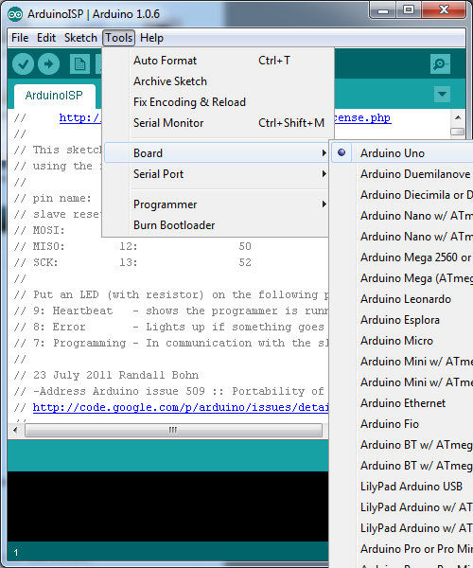
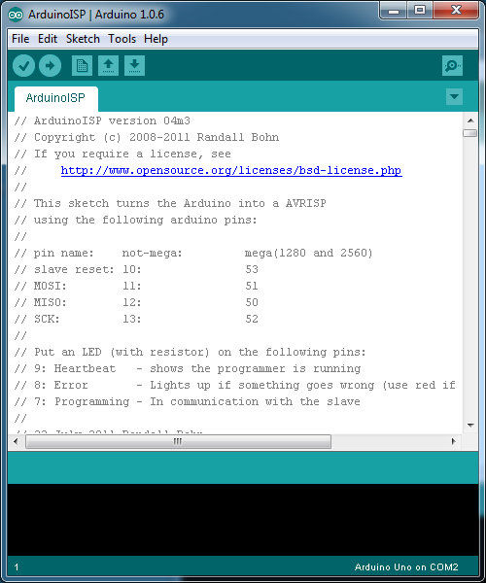
After compiling and linking with the GNU toolchain, also included with the IDE distribution, the Arduino IDE employs the programavrdude to convert the executable code into a text file in hexadecimal coding that is loaded into the Arduino board by a loader program in the board's firmware.
Arduino programs may be written in any programming language with a compiler that produces binary machine code. Atmel provides a development environment for their microcontrollers, AVR Studio and the newer Atmel Studio, which can be used for programming Arduino.

Slide 21
BIBILOGRAPHY
ATMEGA 328 Data Sheets.
www.atmel.com
www.beyondlogic.org
www.wikipedia.org
www.howstuffworks.com
www.alldatasheets.com

Slide 22
THANK ‘Q’

